Slide 1
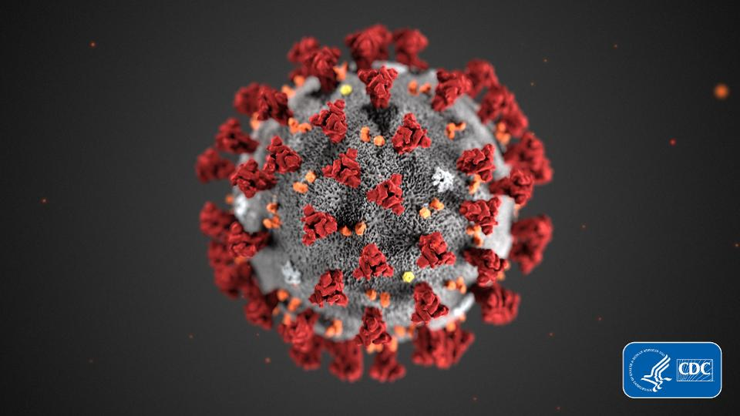
Coronavirus Disease 2019 (COVID-19)
David P. Calfee, MD, MS
Professor of Medicine and Health Policy & Research
3/10/20
21:14
Notes:
Good morning, I’m excited to share several updates in ID that I hope you will find interesting and informative for your practice. I must confess this was a daunting talk to prepare for as there was SO much to chose from

Slide 2
Topics for Discussion
Background
Epidemiology
Clinical disease
Infection prevention and control strategies
Diagnostic testing (Dr. Massimo Loda)
Potential treatment options (Dr. Kristie Marks)

Slide 3
Terminology Review
SARS-CoV-2: the virus
(previously referred to as 2019-nCoV)
Coronavirus Disease 2019 (COVID-19): the disease
Pandemic: an epidemic occurring worldwide, or over a very wide area, crossing international boundaries and usually affecting a large number of people
Last JM. Oxford University Press. 2001.

Slide 4
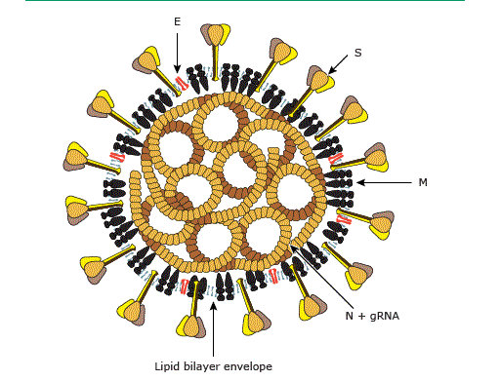
Coronaviruses derive their name from crown-like appearance.
Enveloped RNA virus
Spike (S) protein
  Mediates receptor binding and fusion
  Major antigen
Membrane (M) protein
  Viral assembly
Nucleocapsid (N) protein
  Regulation of RNA synthesis
  Possible antigen
Small envelope (E) protein
  Viral assembly and release
ACE2 Receptor
Letko M Nature Microbiology 2020
UpToDate “Coronaviruses” Adapted from Masters PS in Fields Virology 6th edition
Notes:
Enveloped positive-stranded RNA viruses with characteristic crown like appearance. Glycoprotein spikes (S) protein projects through viral envelope and mediates receptor binding and fusion. Major antigen that stimulate neutralizing antibiody.
M protein involved in viral assembly

Slide 5
Coronavirus disease in humans
Common human coronaviruses
HCoV-229E
HCoV-NL63
HCoV-HKU1
HCoV-OC43
Novel coronaviruses
Severe Acute Respiratory Syndrome Coronavirus (SARS-CoV) - 2003
Middle East Respiratory Syndrome Coronavirus (MERS-CoV) - 2012
Severe Acute Respiratory Syndrome Coronavirus-2 (SARS-CoV-2) - 2019
Detected by the respiratory pathogen panel multiplex PCR

Slide 6
Novel coronaviruses emerge from animal reservoirs.
Spillover events: bats → intermediate host → humans
Wit Nature Review Micro 2016

Slide 7


Wuhan, China is a city with population of more than 11 million people.
Initial cases linked to the Huanan Wholesale Seafood Market
SARS-CoV-2 first isolated from BAL samples obtained on December 30, 2019
https://www.sciencemag.org/news/2020/01/novel-human-virus-pneumonia-cases-linked-seafood-market-china-stir-concern
https://www.nytimes.com/2020/01/25/world/asia/china-markets-coronavirus-sars.html
https://www.nature.com/articles/d41586-020-00364-2

Slide 8

Our urban and global society increases opportunities for dissemination.
https://bluedot.global/

Slide 9
COVID-19 Timeline
Date | Event
December 8, 2019 | First case in China
December 30, 2019 | BAL samples collected from which the virus was first isolated
January 7, 2020 | Novel virus identified
January 16, 2020 | First case reported outside of China
January 30, 2020 | WHO declares a “Public Health Emergency of International Concern”
February 29, 2020 | First death in US
March 7, 2020 | NYS Governor declares a State of Emergency
March 10, 2020 | NYS creates a “containment area” in New Rochelle

Slide 10
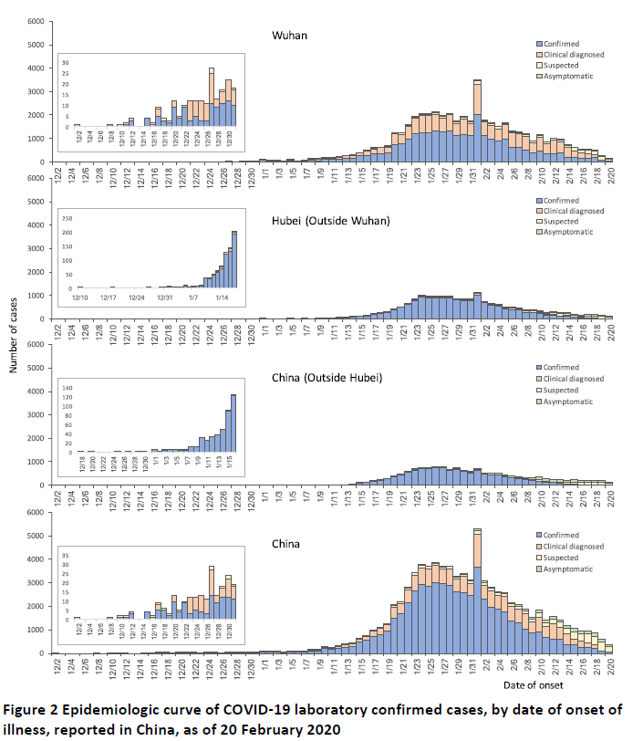

Slide 11
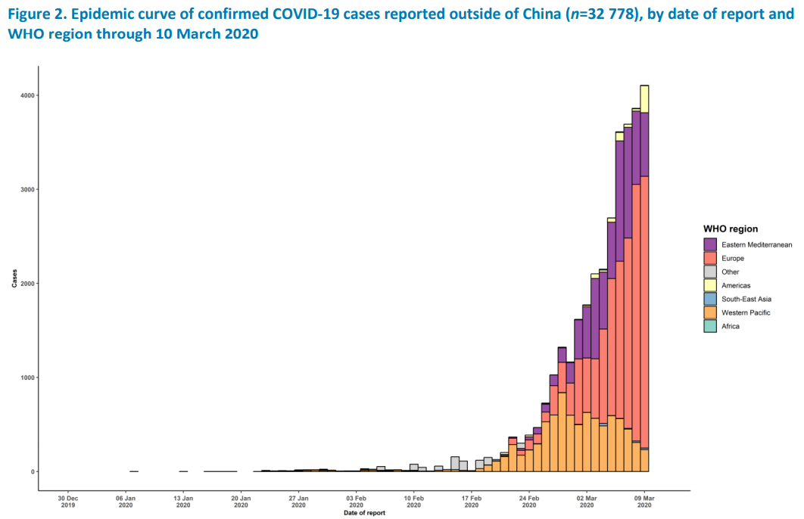
The spread of SARS-CoV-2 outside of China is increasing.

Slide 12
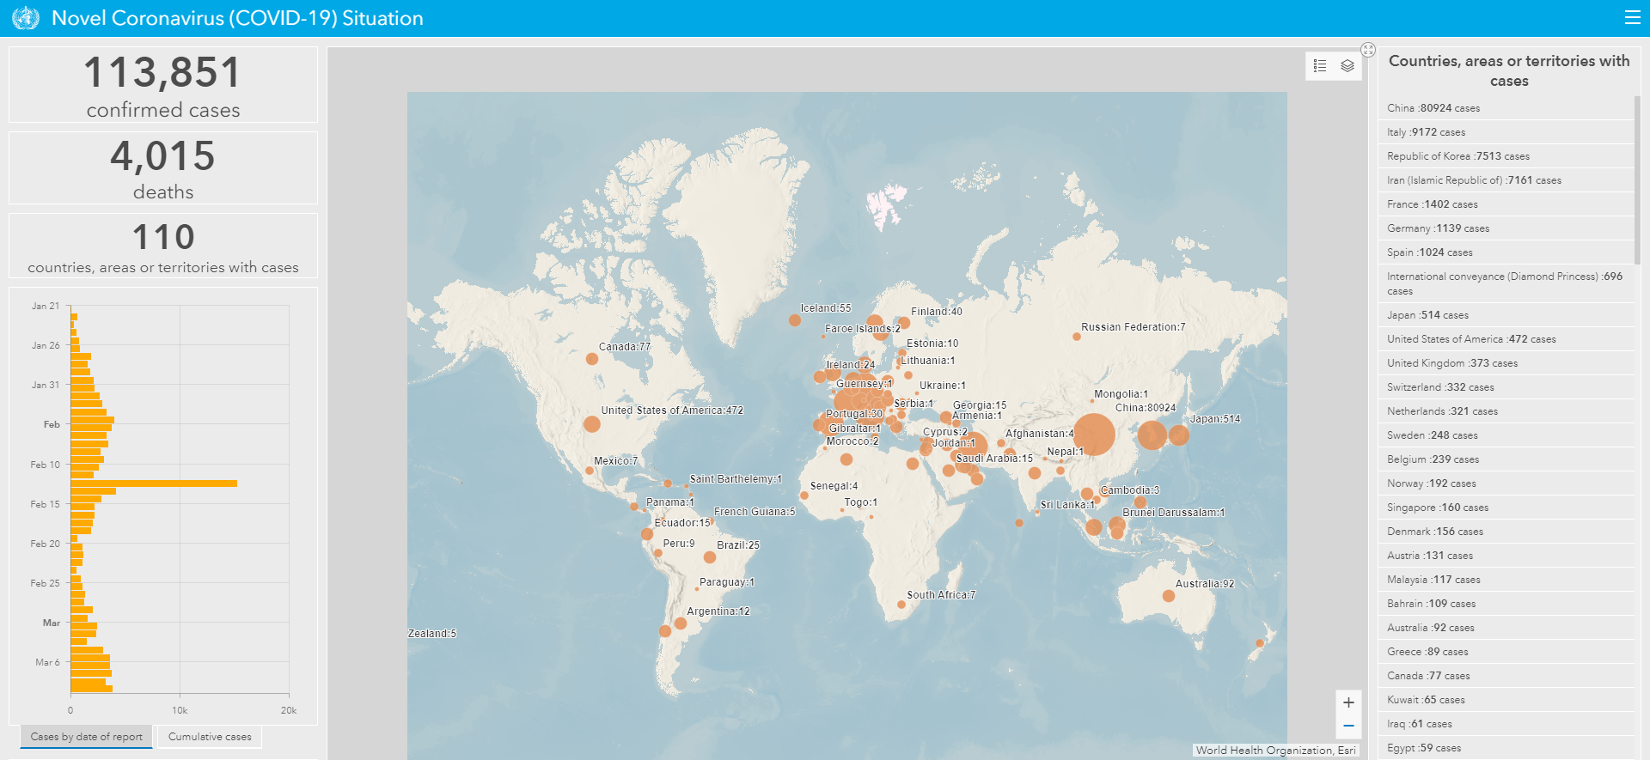
COVID-19 has now been detected on 6 continents.
As of 3/10/20
https://experience.arcgis.com/experience/685d0ace521648f8a5beeeee1b9125cd

Slide 13
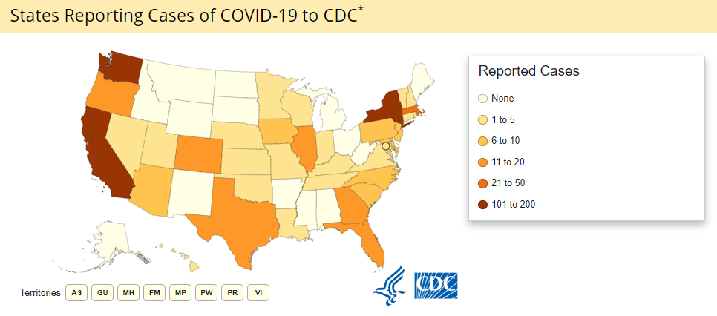
Community transmission of SARS-CoV-2 is increasing in the U.S.
(as of 3/9/20)
Total: 647 (36 jurisdictions)
Deaths: 25
New York State | 173
NYC | 36
Non-NYC | 137
As of 3/10/20 at 11:15 am

Slide 14
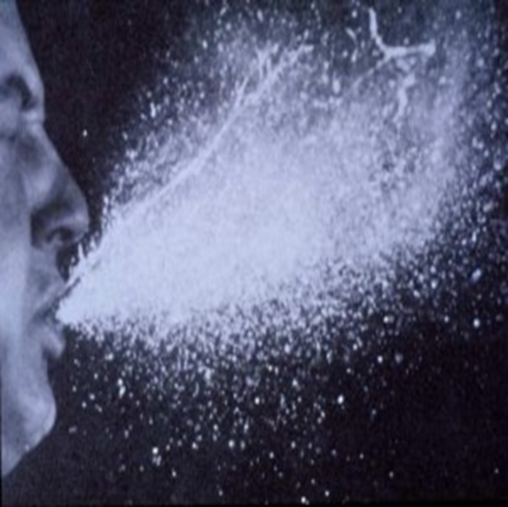
Transmission of SARS-CoV-2 is largely by close person-to-person transmission.
Respiratory droplets (primary)
Contact
Airborne transmission over long distances is thought not to be likely.
Estimated reproduction number (r_{o}): ~2-2.5
www.cdc.gov/coronavirus/2019-ncov/

Slide 15
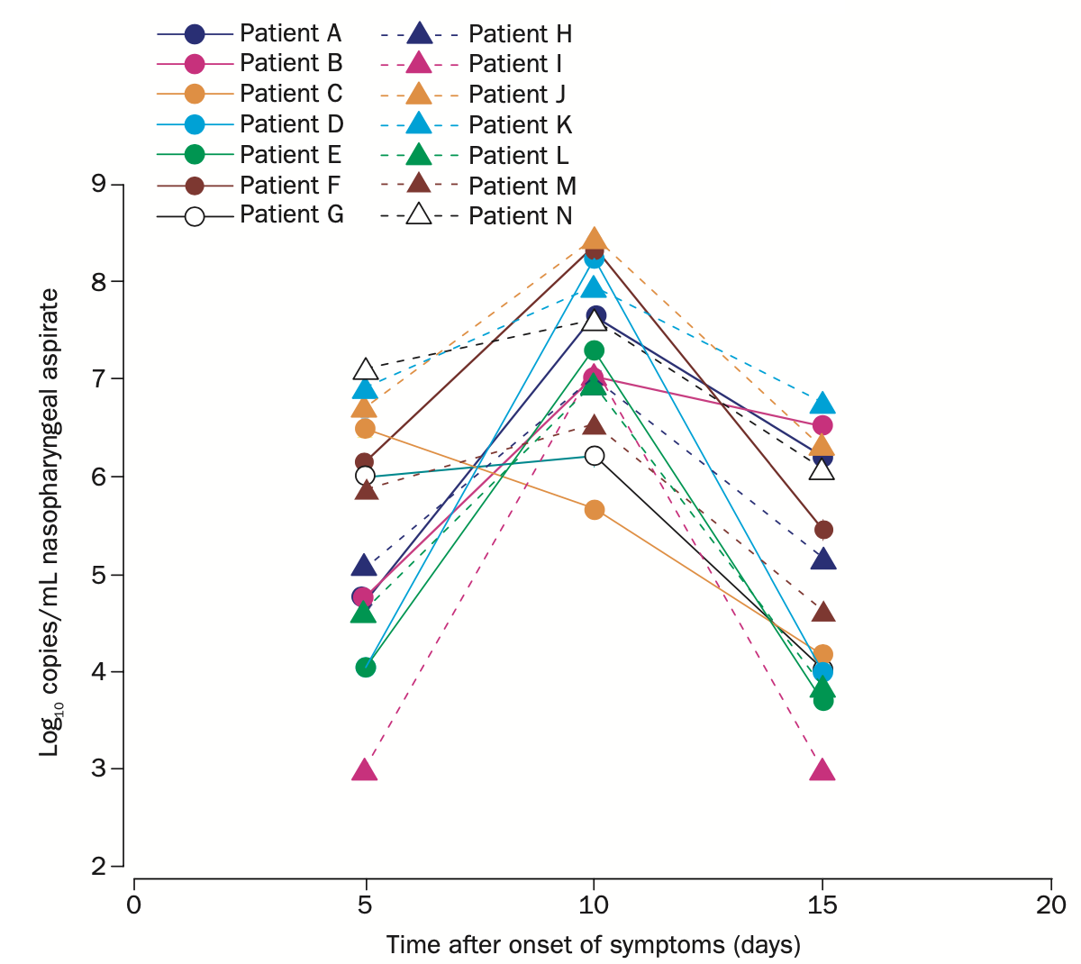
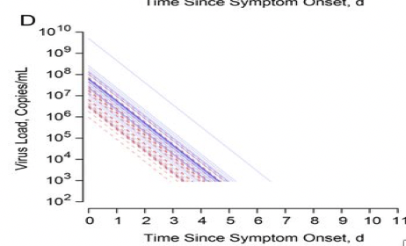
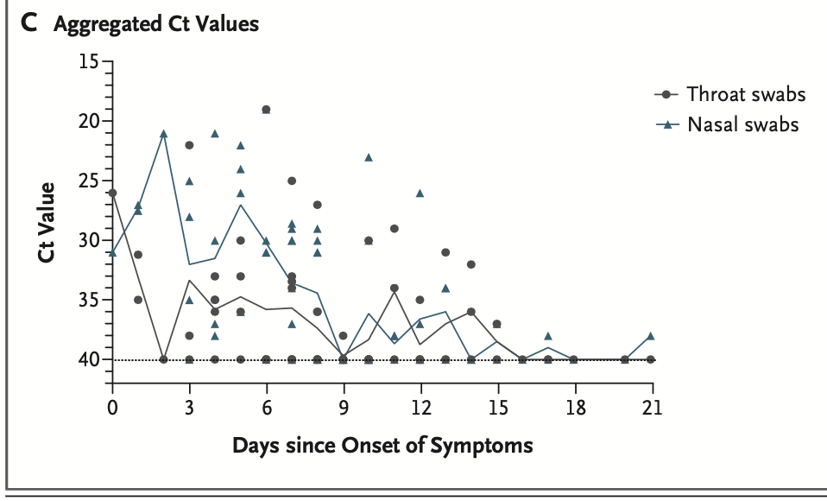
Viral shedding patterns of SARS-CoV-2 resemble influenza.
SARS-CoV
SARS-CoV-2
Seasonal Influenza
Zou et al, NEJM 2020; DOI: 10.1056/NEJMc2001737
Peiris et al, Lancet 2003; 361: 1767-72
Tsang et al, J Infect Dis 2015; 212; 1420-28

Slide 16
Epidemiological characteristics of COVID-19 in China
72,314 cases in China
Confirmed: 44,672 (62%)
Age distribution
>80 years: 3%
30-79 years: 87%
20-29 years: 8%
10-19: 1%
<10 year 1%
Wu Z. JAMA 2020

Slide 17
Clinical characteristics
Characteristic |  | 1099 COVID-19 Cases
Incubation period (median (IQR) |  | 4 (2-7)
Symptoms
 | Fever on admission | 43.8%
 | Fever during hospitalization | 88.7%
 | Cough | 67.8%
 | Sputum production | 33.7%
 | Shortness of breath | 18.7%
 | Myalgia | 14.9%
 | Sore throat | 13.9%
 | Headache | 13.6%
 | Chills/rigors | 11.5%
 | Nausea or vomiting | 5%
 | Diarrhea | 3.8%
 | Rhinorrhea | 4.8%
Guan, W NEJM 2020

Slide 18
Laboratory and imaging findings
Lab/imaging finding | 1,099 COVID-19 Cases
Any CXR abnormalities | 59.1%
Any CT abnormalities | 86.2%
WBC count (median (IQR)) | 4700 (3500-6000)
WBC count >10,000 | 5.9%
Lymphocyte count (median (IQR)) | 1000 (700-1300)
Lymphocytopenia <1500 per mm³ | 83.2%
Thrombocytopenia < 150,000 | 36.2%
LDH >250 U/liter | 41%
Procalcitonin elevated >0.5 ng/ml | 5.5%
AST/ALT >40 U/liter | 21-22%
Guan, W NEJM 2020

Slide 19
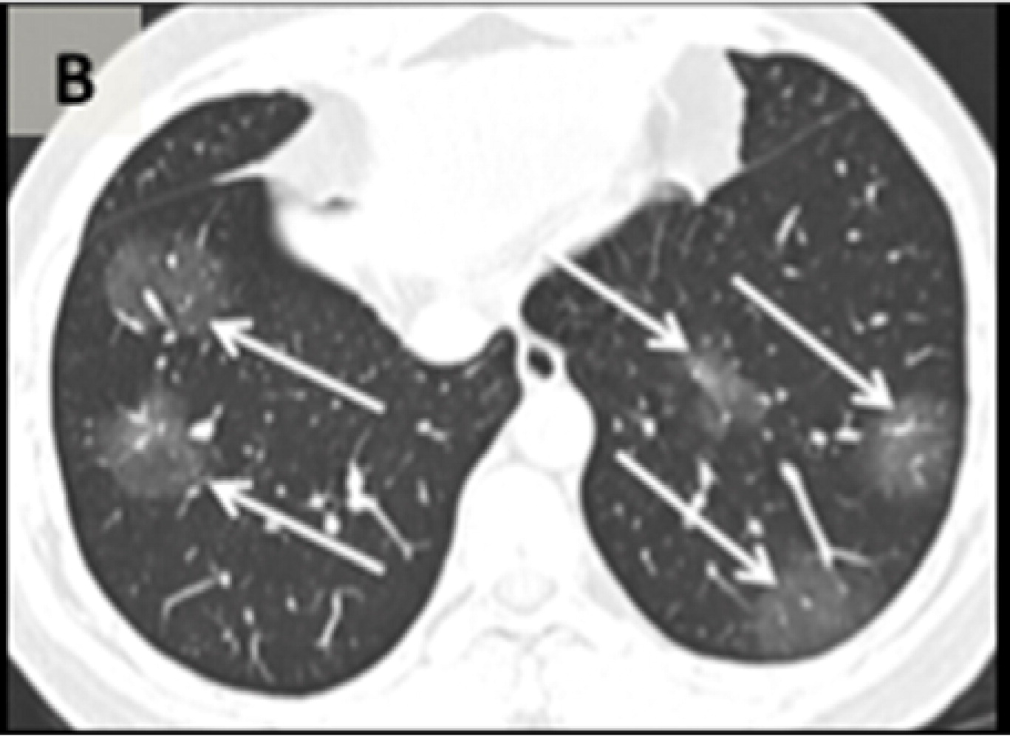
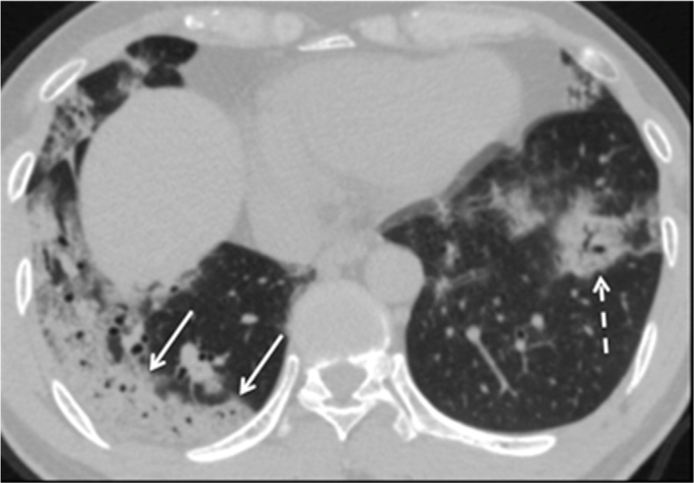
CT findings include rounded ground glass opacities→ progressive airspace opacities
Early
Late
Bernheim A Radiology 2020

Slide 20
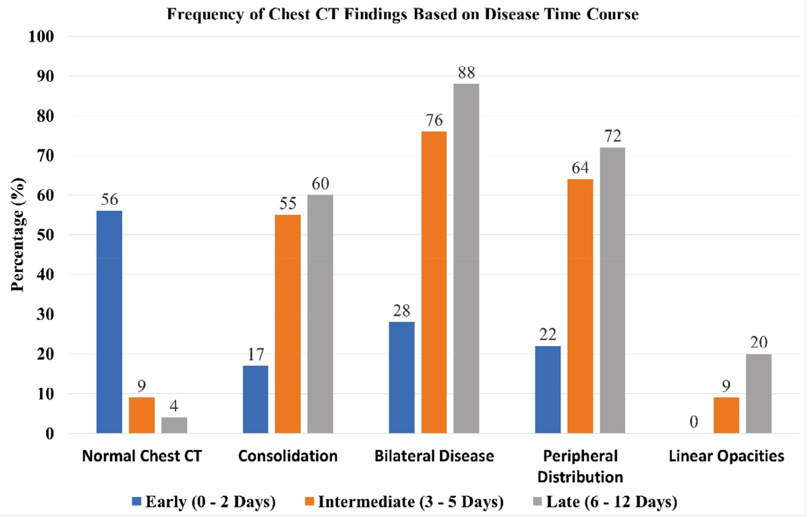
Progression of CT abnormalities in 121 symptomatic patients with COVID-19
Bernheim A Radiology 2020

Slide 21
Complications of COVID-19
Complication | 1,099 COVID-19 Cases
Septic shock | 1.1%
ARDS | 3.4%
Acute kidney injury | 0.5%
Non-invasive mechanical ventilation | 5.1%
Invasive mechanical ventilation | 2.3%
Use of extracorporeal membrane oxygenation | 0.5%
Death | 1.4%
Guan, W NEJM 2020

Slide 22
Epidemiological characteristics of COVID-19 in China
Case-fatality rate (CFR): 2.3% overall (1,023/44,672)
>80 years: 14.8%
70-79 years: 8.0%
CFR was greatest early in the outbreak.
CFR higher among those with chronic medical conditions:
Cardiovascular disease (10.5%)
Diabetes (7.3%)
Chronic respiratory disease (6.3%)
Hypertension (6.0%)
Cancer (5.6%)
Wu Z. JAMA 2020

Slide 23
Prevention and control measures
Strategies
Containment
Mitigation
Public settings
Healthcare settings

Slide 24
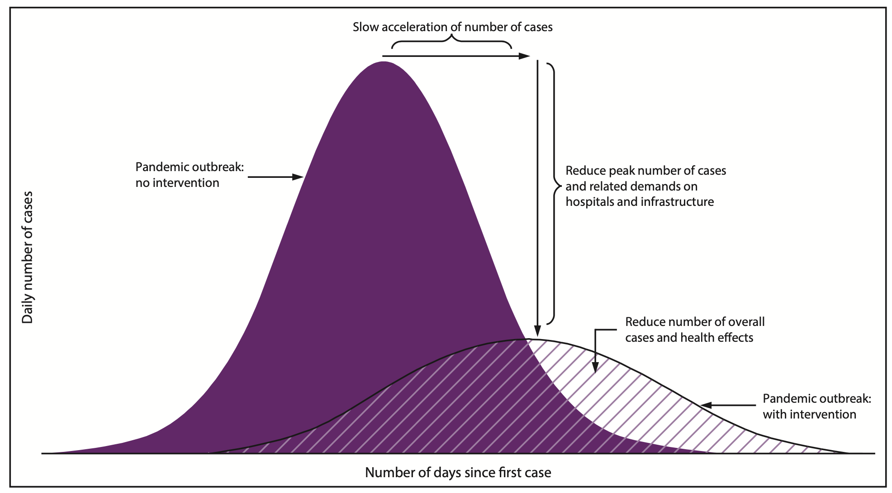
The role of mitigation strategies
https://www.cdc.gov/mmwr/volumes/66/rr/rr6601a1.htm

Slide 25
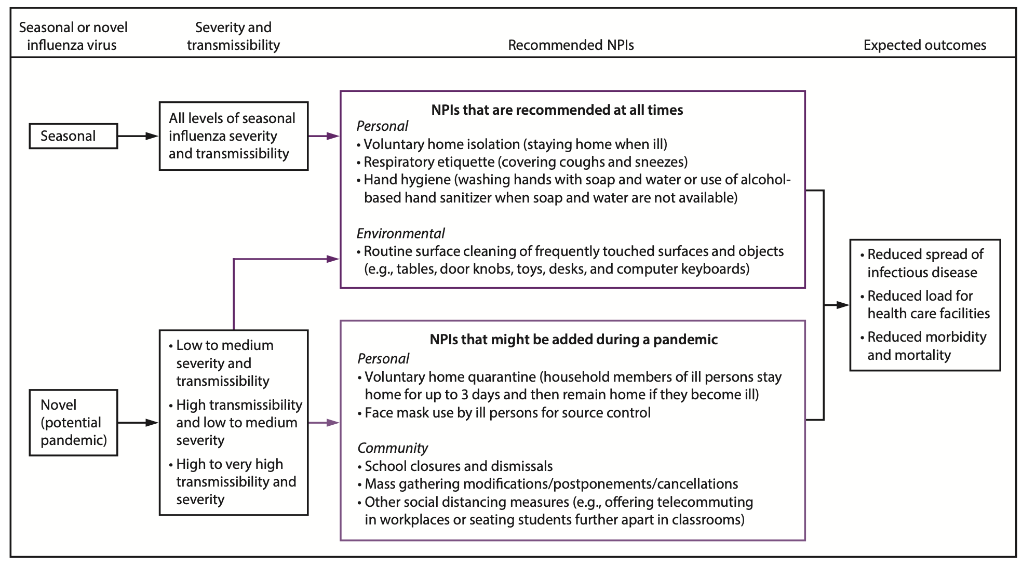
Population-Based Mitigation Strategies
https://www.cdc.gov/mmwr/volumes/66/rr/rr6601a1.htm

Slide 26
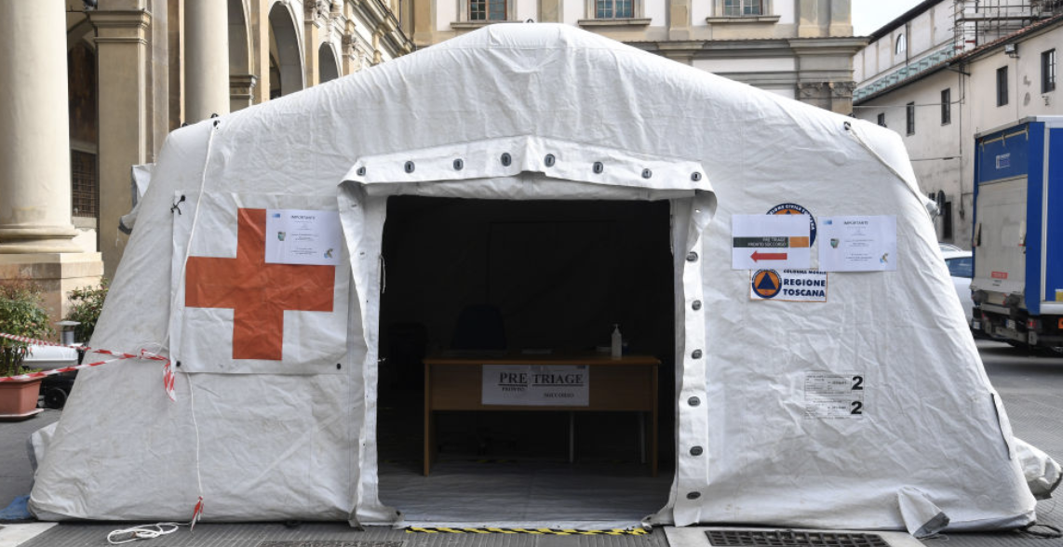
Pandemic planning for healthcare settings
Surge capacity
Triage
Patient care space
Ventilator support
Supplies
Staff

Slide 27
Transmission can be prevented in healthcare-settings.
Minimize risk of exposure
Before arrival
Upon arrival/during visit: implement source control measures immediately
  Visual alerts
  Supplies (hand hygiene, masks)
  Screening for signs/symptoms
  Physical separation from others
    Single room with door closed (partitions, distance)
Limit/restrict visitors, limit staff entering room.
https://www.cdc.gov/coronavirus/2019-ncov/infection-control/control-recommendations.html?CDC_AA_refVal=https%3A%2F%2Fwww.cdc.gov%2Fcoronavirus%2F2019-ncov%2Fhcp%2Finfection-control.html Updated 3/10/20

Slide 28
Transmission can be prevented in healthcare-settings
Standard and transmission-based precautions
Hand hygiene
Equipment, environment cleaning and disinfection
Personal protective equipment (PPE) for HCP
  Droplet precautions (mask with eye protection)
  Contact precautions (gown and gloves)
  Aerosol-generating procedures: N95 respirator
https://www.cdc.gov/coronavirus/2019-ncov/infection-control/control-recommendations.html?CDC_AA_refVal=https%3A%2F%2Fwww.cdc.gov%2Fcoronavirus%2F2019-ncov%2Fhcp%2Finfection-control.html Updated 3/10/20

Slide 29

Stay informed!

Slide 30
Diagnostic testing: who should be tested for COVID-19?
Priorities for testing include:
Hospitalized patients with compatible signs/symptoms
Any person, including healthcare personnel, who within 14 days of symptom onset had close contact
Symptomatic individuals who are at higher risk of complications
  Age >65
  Immunocompromised
  Chronic medical conditions
Mildly ill patients
  Advise to stay home while ill, contact provider prior to presenting for care
NYCDOH and NYSDOH guidance
https://www.cdc.gov/coronavirus/2019-nCoV/hcp/clinical-criteria.html.

