Slide 1
Clinical Management and Treatment
 | CDC | WHO
Monitoring inpatient vs. outpatient | Mild may not require initial hospitalization May progress to lower respiratory infection in second week of illness Monitor closely Decision based on clinical presentation, ability to engage in monitoring, home isolation, and risk of transmission Possible risk factors progression older age, chronic medical conditions including lung disease, DM, immunocompromise, pregnancy | Triage: recognize and sort all patients with SARI at first point of contact with health care system (such as the emergency department) Triage patients and start emergency treatments based based on disease severity.
Interim Clinical Guidance for Management of Patients with Confirmed Coronavirus Disease (COVID-19), CDC, revised 3/7/20
Clinical management of severe acute respiratory infection when novel coronavirus (nCoV) infection is suspected, Interim guidance, WHO 1/28/20
Notes:
Mention in addition to infonet frequently updated interim guidance on clinical management from CDC and WHO

Slide 2
Clinical Management and Treatment
 | CDC | WHO
Treatment | No COVID specific treatment Supportive management including advanced organ support | No COVID specific treatment Several pages of management recommendations supportive care
Systemic Corticosteroids | Avoid unless indicated for other reasons like septic shock or COPD | Do not routinely give for treatment of viral pneumonia or ARDS outside of clinical trials unless indicated for another reason.
Investigational | No RCT data to recommend any specific therapy yet | No current evidence from RCTs to recommend any specific [treatment] Unlicensed treatments should be administered thru ethically-approved clinical trials or the Monitored Emergency Use of Unregistered Interventions Framework with strict monitoring

Slide 3
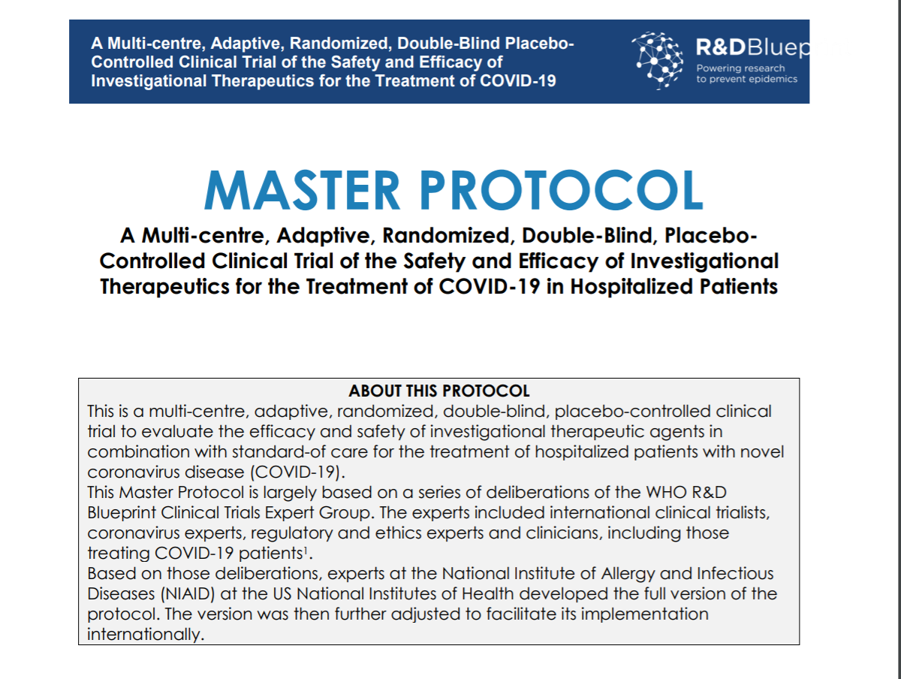
https://www.who.int/blueprint/priority-diseases/key-action/COVID-19_Treatment_Trial_Design_Master_Protocol_synopsis_Final_18022020.pdf?ua=1

Slide 4
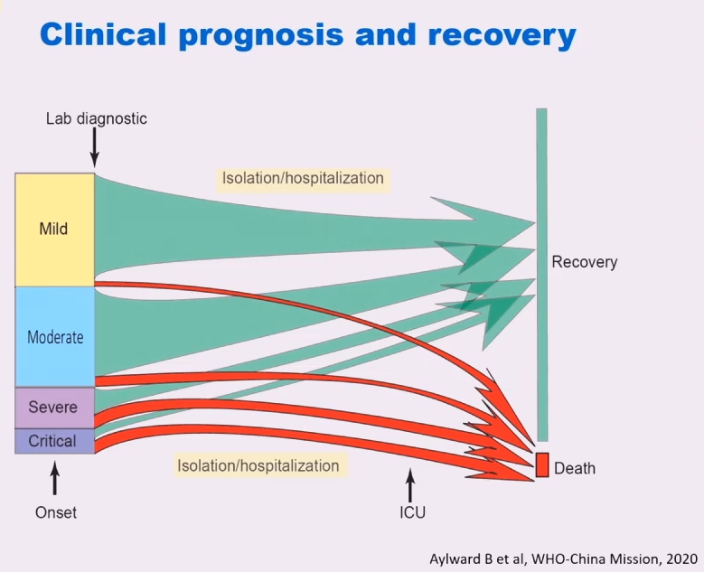
VIRUS DETECTED ALL PHASES OF ILLNESS

Slide 5
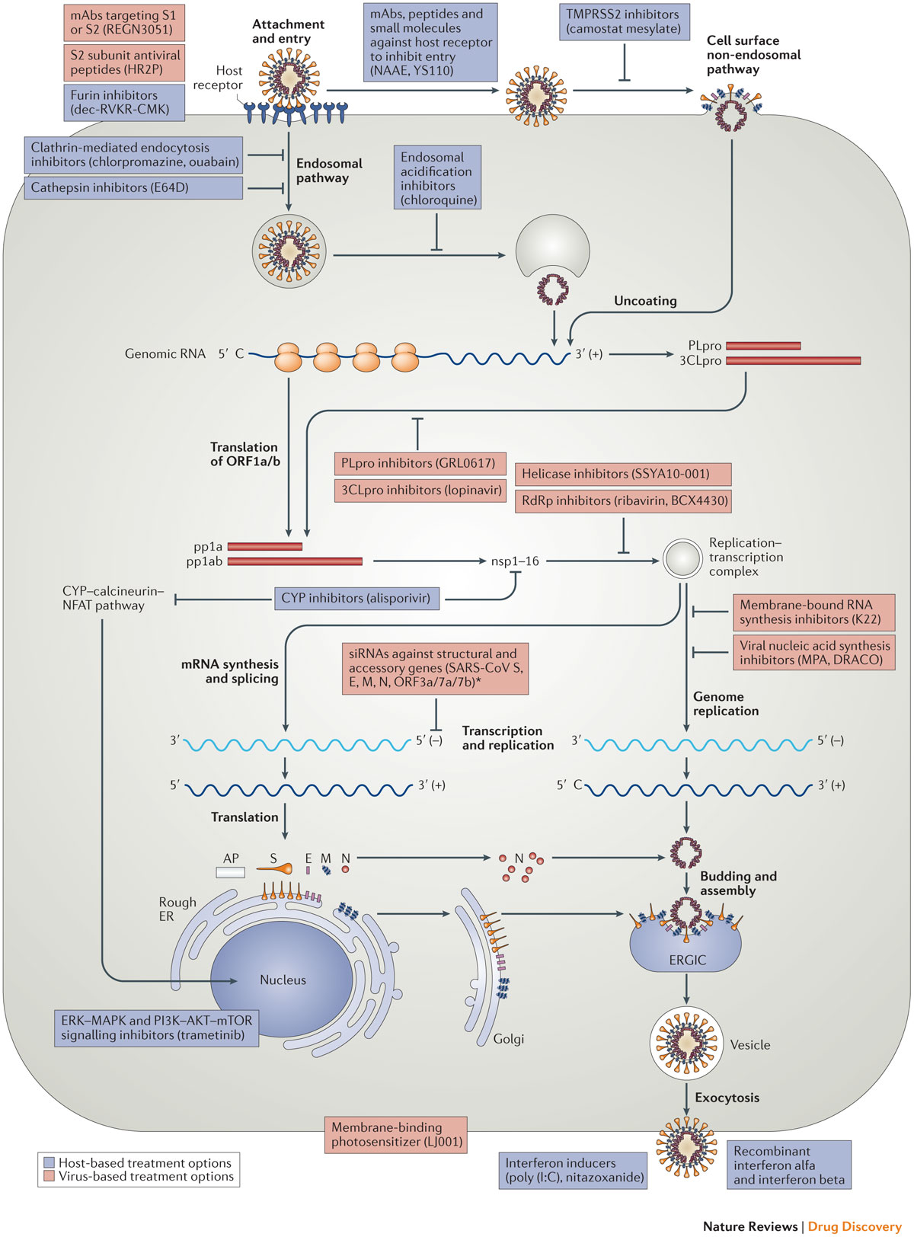
Potential Antiviral Targets
Block virus RNA synthesis and replication
  RNA-dependent RNA polymerase (RdRp)
  Viral proteases: PLpro and 3CLpro
  Helicase
Target viral spike glycoprotein S (S1 an S2 domain)
  Block host cell receptor binding and fusion
Block host specific receptor and enzymes
  ACE2 host receptor
Host-based approaches
  Recombinant Interferons
  Immune modulators
Zumla et al. Nature Reviews Drug Discovery 2016
Li & De Clerq. Nature Reviews Drug Discovery, 2020
Slide courtesy of Magda Sobieszczyk –
Notes:
Given virus detected in all phases of illness, stopping viral replication reasonable strategy at any stage of illness

Slide 6
Evaluate Existing Antivirals: RNA-dependent-polymerases
  Remdesivir (investigational)
    Developed and tested to treat Ebola
      Safety database in >500 individuals
    in vitro antiviral activity against SARS CoV-2
    Activity against MERS-CoV in macaque model
    Outcompetes proofreading ability of exonuclease
  Favipiravir (investigational, except approved in Japan for influenza)
    in vitro antiviral activity against SARS CoV-2
    Efficacy study evaluating in combination with interferon-α
  Ribavirin (HCV and RSV):
    Tested against SARS Co-V, MERS: anemia
    Potency against COVID-19 unclear
Li & De Clerq. Nature Reviews Drug Discovery, 2020
Wang, M. et al. Cell Res. 2020
Agostini et al. mBio, 2018
Holshue, NEJM 2020
Slide courtesy of Magda Sobieszczyk modified by KM

Slide 7
Remdesivir for COVID-19 Infection
Mechanism = adenosine nucleoside analog
Activity against many viruses including Ebola, SARS, MERS, and COVID-19
Found to be ineffective in Ebola, but safe in > 500 individuals treated
Two phase III trials ongoing for mild/moderate and severe COVID-19
  200 mg IV loading dose on Day 1 followed by 100 mg IV once daily to complete 10 days
    Currently enrolling cruise ship passengers
Single Patient IND for compassionate use in confirmed COVID-19
  Requires approval from Gilead and FDA (Form 3296)
  Key exclusion criteria: CrCl <30, ALT >5x ULN, on pressor support to maintain BP, other experimental agents, multiorgan failure
Slides origin Shawn Mazur, PharmD, Monica Mehta, PharmD, Christine Kubin, PharmD, updated by KM

Slide 8
NYPH Experience Compassionate Use Remdesivir
As of 3/11/20, 2 critically-ill patients approved for use of remdesivir for compassionate use:
  Pt #1: MICU at NYP/CU, started therapy 3/5/20
  Pt #2: MICU at NYP/WC, admitted 3/6, approved 3/7/20 by Gilead then FDA, drug received early 3/9, patient clinically improving and declined dosing
Requested on 2 others – not eligible
  Pt #3: CICU at NYP/WC, CrCl <30, ALT >5xULN, pressors
  Pt #4: MICU at NYP/LMH, was eligible but developed CrCl<30 after requested

Slide 9
Coronavirus RNA Protease inhibitors papain-like cysteine protease (PLpro)
3C‑like serine protease (3CLpro)
Approved HIV-1 protease inhibitors lopinavir boosted with ritonavir (Lopinavir/r) evaluated in SARS and MERS
Clinical experience with SARS-CoV
  Non-randomized trial of lopinavir/r vs historical controls treated with ribavirin
  Lower risk of ARDS or death compared with ribavirin alone but limitations of study design
Effective for SARS CoV-2?
  PK data do not support - SARS CoV-2 is 100X less susceptible to lopinavir than HIV and is not likely to be effective at available doses
  Early/Preliminary data from 52 patients in lopinavir/r vs 48 controls
    lopinavir/r NOT better than placebo at reducing symptoms or viral levels
  Phase 3 Open label study of Lopinavir/r in patients with mild COVID-19
Morse J et al, ChemBio, 2020
Chu, Thorax, 2004
Chen. Chinese Journal of Infectious Diseases, 2020
Slide courtesy of Magda Sobieszczyk modified by KM
Notes:
Coronavirus protease inhibitors have
However PK data and clinical trials hav

Slide 10
Selected Antiviral Compounds against Human Coronaviruses
Infectious diseases | Drug targets | Antiviral agents | Reported mechanism of action | Status
Influenza, SARS-CoV-2 | RdRp Polymerase | Favipiravir | Inhibits RdRp | Approved for influenza in Japan • Randomized trial for COVID-19
SARS-CoV-2; MERS-CoV, SARS-CoV; HCoV-229E; HIV, HPV | 3CLpro protease | Lopinavir/r | Inhibits 3CLpro | • Approved for HIV • Phase 2/3 for MERS (MIRACLE trial) • Phase 3 for COVID-19 (NCT04255017, ChiCTR2000029539)
SARS-CoV-2 | 3CLpro protease | Darunavir/ cobicistat | Inhibits 3CLpro | Approved for HIV • Phase 3 for COVID-19 NCT04252274
SARS-CoV, MERS-CoV | Spike glycoprotein | Peptide P9 | Inhibits cell entry and fusion | Preclinical
MERS-CoV | S2 subunit of Spike protein | HR2P-M1 HR2P-M2 | Inhibits MERS-CoV Spike protein mediated fusion | Preclinical
Li & De Clerq. Nature Reviews Drug Discovery, 2020; Sheahan TP et al Nature Commun 2020; Arabi YM et al Trials. 2018; De Wilde AH et al. Antimicrobial agents and chemo 2014; Chan JF JID 2015; Kim UJ et al, Antivir Ther 2016
Slide courtesy of Magda Sobieszczyk
Notes:
Monocoolo

Slide 11
Selected Host-based Treatment Strategies
Infectious diseases | Drug targets | Antiviral agents | Reported mechanism of action | Status
SARS-CoV SARS-CoV-2 MERS-CoV | Interferon response | Recombinant interferon | Exogenous interferons | Randomized trial for COVID-19 with ribavirin
SARS-CoV-2; MERS-CoV, SARS-CoV; | Endosomal acidification | Chloroquine | Lysosomatropic base that appears to disrupt intracellular trafficking and viral fusion events | Open label trial for COVID-19 Hydroxychloroquine also being investigated
Coronaviruses | Interferon response | Nitazoxanide | Induces the host innate immune response to produce interferons by the host’s fibroblasts and protein kinase R activation | Diarrhea caused by protozoa
Li & De Clerq. Nature Reviews Drug Discovery, 2020; Manli et al, Cell Res 2002; de Wilde et al, Antimicrob Agents Chemo 2014; Falzarano, Nat Med 2014; Omrani, Lancet Inf Dis 2014; Arabi et al, Clin Infect Dis 2019
Slide courtesy of Magda Sobieszczyk
Notes:
Chloroquine is an anti-malarial agent with broad-spectrum antiviral activity
Also has immune-modulating activity which may enhance its antiviral effect
Previous studies of chloroquine and analogues for treatment of dengue, HCV, chikungunya and HIV-1 infections
Recently found to have activity in vitro against COVID-19 at concentrations that may be clinically achievable
News briefing (China): results from >100 patients suggest that chloroquine phosphate may be superior to control treatment in inhibiting the exacerbation of pneumonia, improving lung imaging findings, promoting a virus-negative conversion, and shortening the disease course in COVID-19 pneumonia
Currently unavailable in the US
Hydroxychloroquine: less toxic metabolite of chloroquine used to treat rheumatic diseases
Being investigated in clinical trial for COVID-19

Slide 12
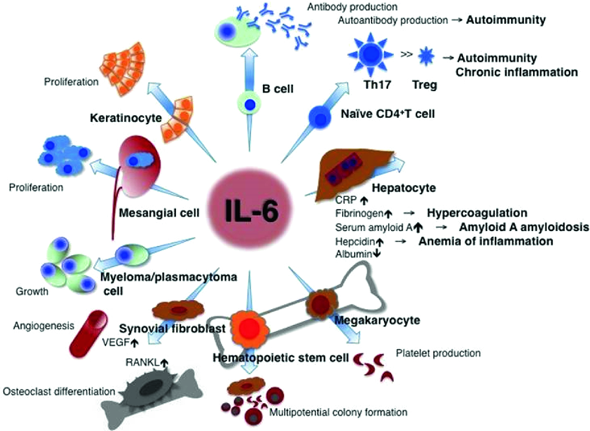
Immunomodulation to control host immune response
Variety of immunomodulatory drugs in study
Anti Interleukin-6 Blockade
  E.g. Tocilizumab, siltuximab, sarilumab, etc
  Tocilizumab
    humanized anti-IL-6R monoclonal antibody
    first drug to be found to successfully block the IL-6 signal
    binds to both cell-surface and soluble IL-6R
  Used for cytokine release syndrome related to CAR T cell infusion (also used in RA and off label many other diseases)
  Small retrospective study of 21 patients (chinaXiv:202003.00026v1)
  RCT tocilizumab initiated in China, (ChiCTR2000029765, 2/13/20)

Slide 13
Coronavirus Treatment Summary
To date no specific drug/drug combo with proven efficacy against coronavirus
Mainstay is supportive management including advanced organ support for patients with severe disease
Both novel and repurposed therapies under investigation
Different therapies may be beneficial for different phases and presentations of COVID-19 illness
*Special thanks to Shawn Mazur PharmD and Magda Sobieszczyk MD, MPH for sharing their slides and expertise

